Slide 1
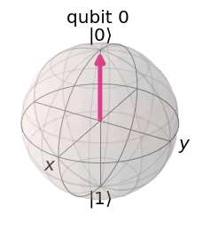
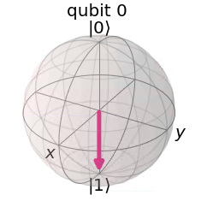
Single qubit – definite states on bloch sphere
|0>
|1> state

Slide 2
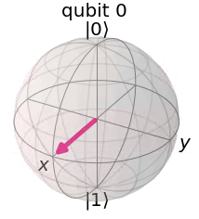
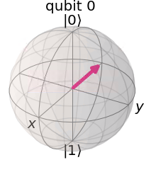


Equal superposition states
$|+> = \frac{1}{\sqrt{2}}$|0> + $\frac{1}{\sqrt{2}}$|1>
$|−> = \frac{1}{\sqrt{2}}$|0> - $\frac{1}{\sqrt{2}}$|1>

Slide 3
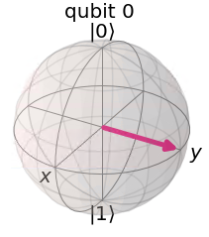
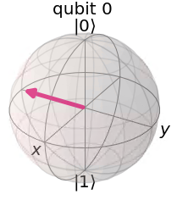


Equal superposition states
$|i> = \frac{1}{\sqrt{2}}$|0> + $\frac{1}{\sqrt{2}}$i|1>
$|−i> = \frac{1}{\sqrt{2}}$|0> - $\frac{1}{\sqrt{2}}$i|1>

Slide 4
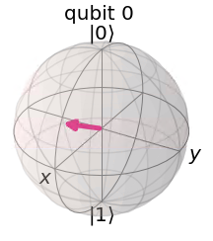
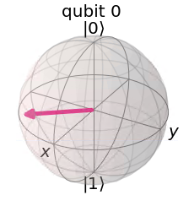


superposition states
$|ψ> = \frac{\sqrt{3}}{2}$|0> + $\frac{1}{2}$|1>
$|ψ> = \frac{2}{3}$|0> + $\frac{1−2i}{3}$|1>

Slide 5
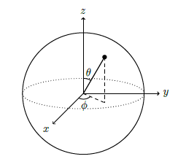
Spherical coordinates

